Slide 1

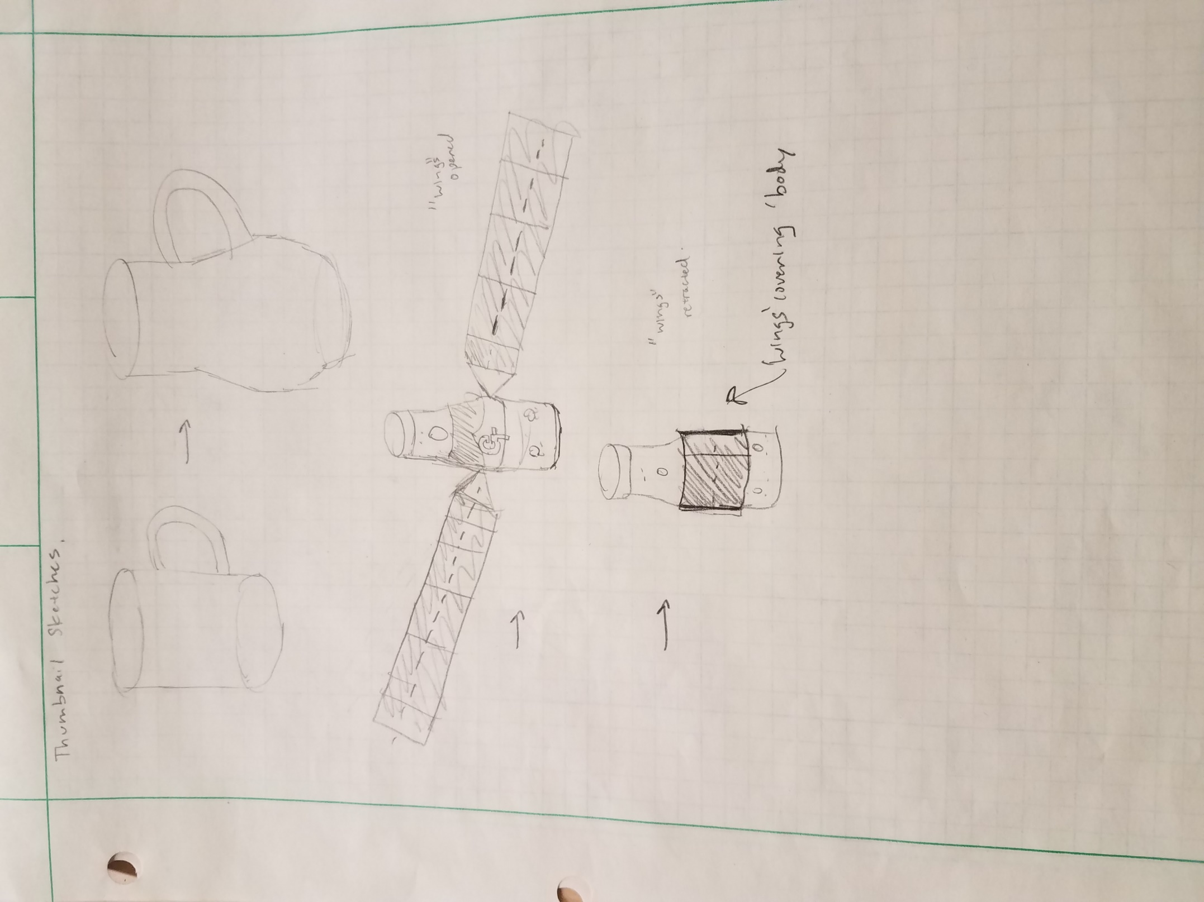
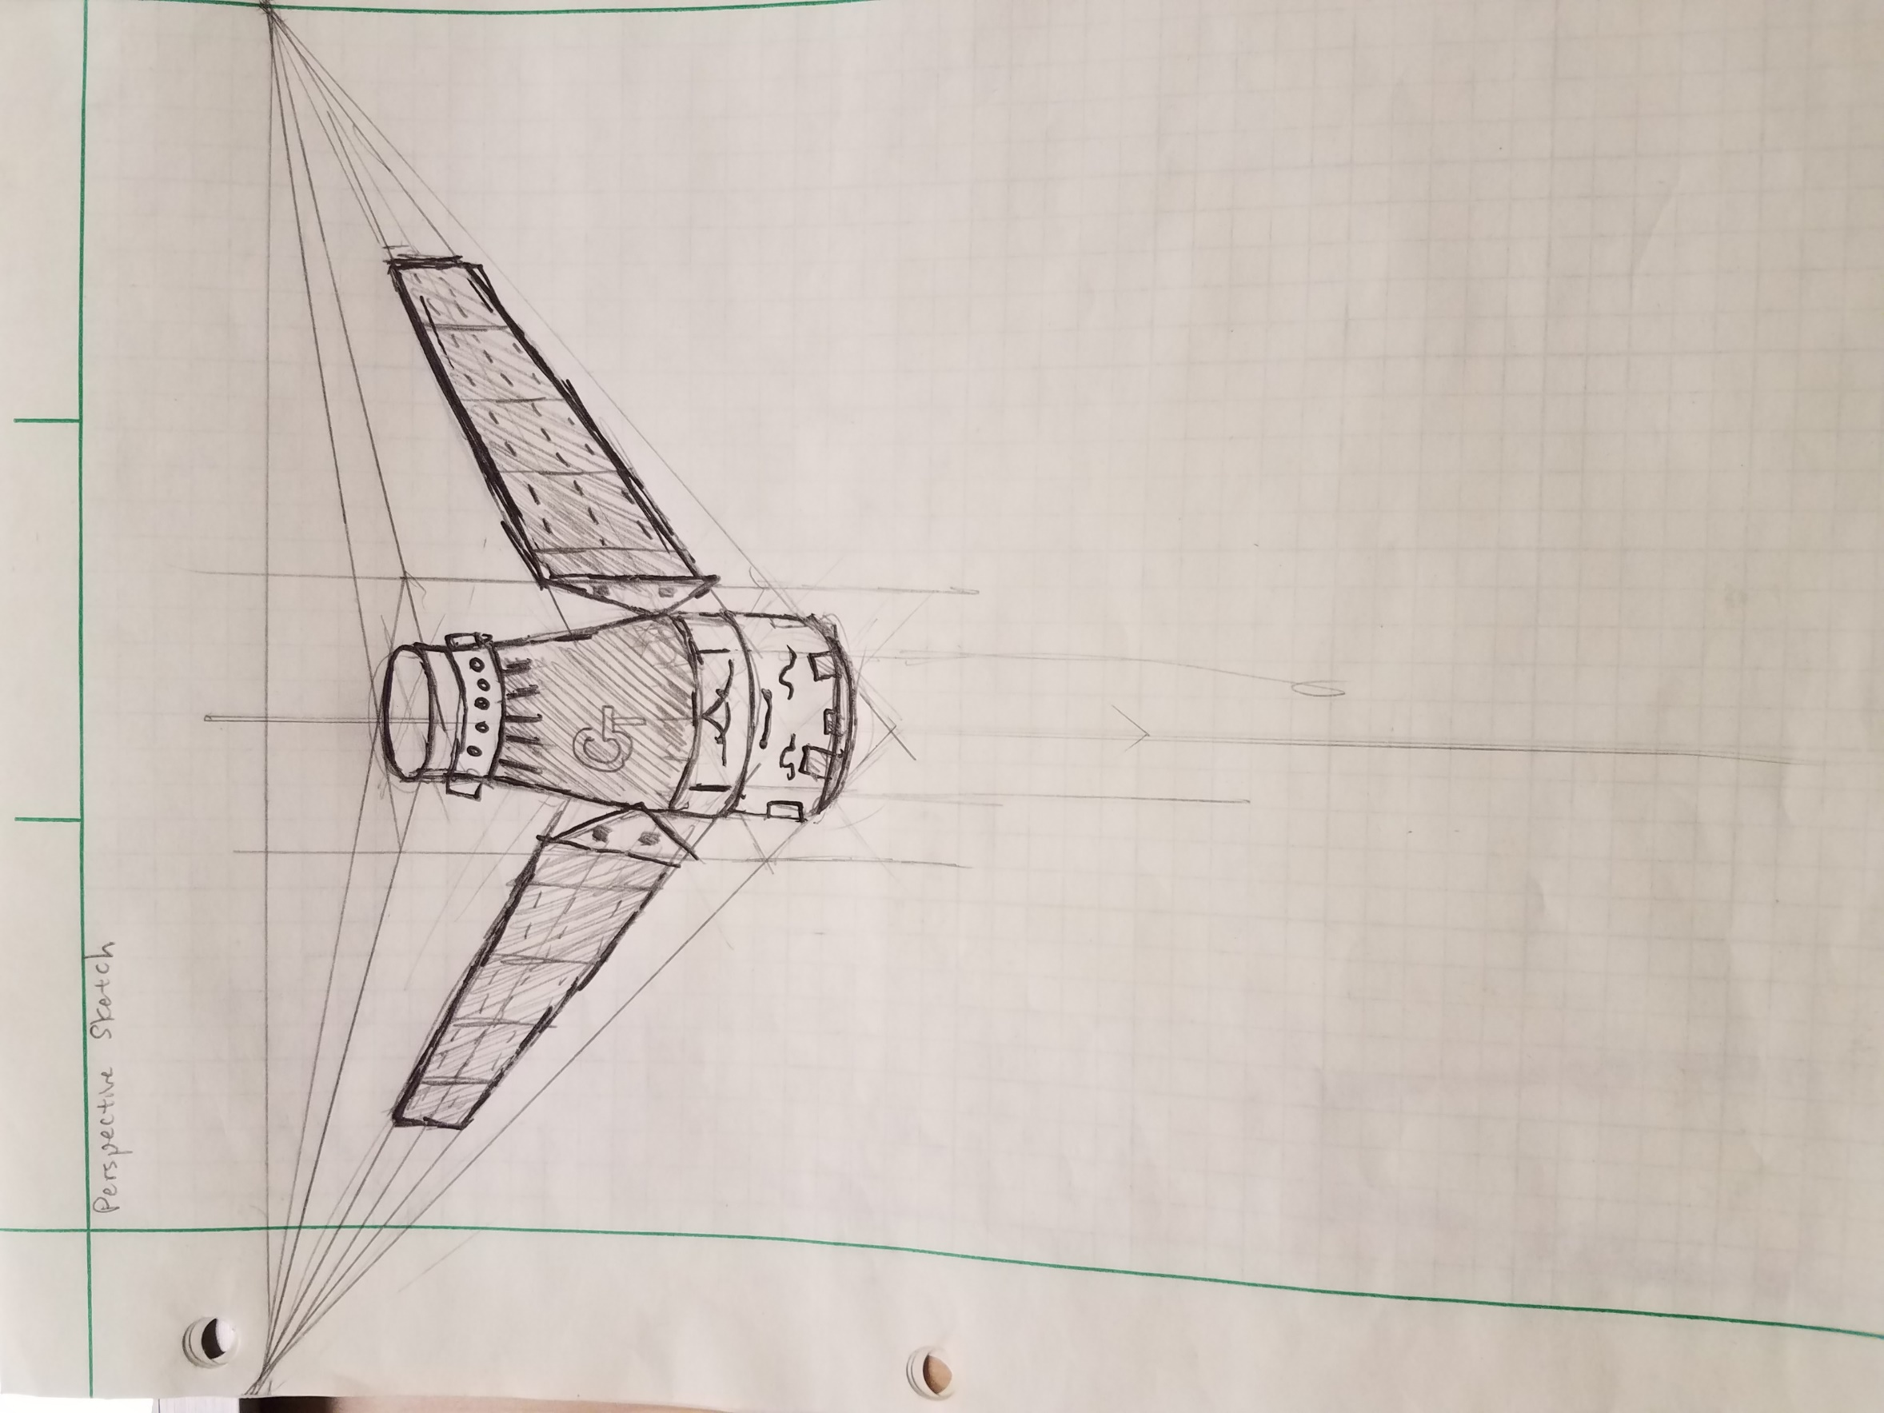
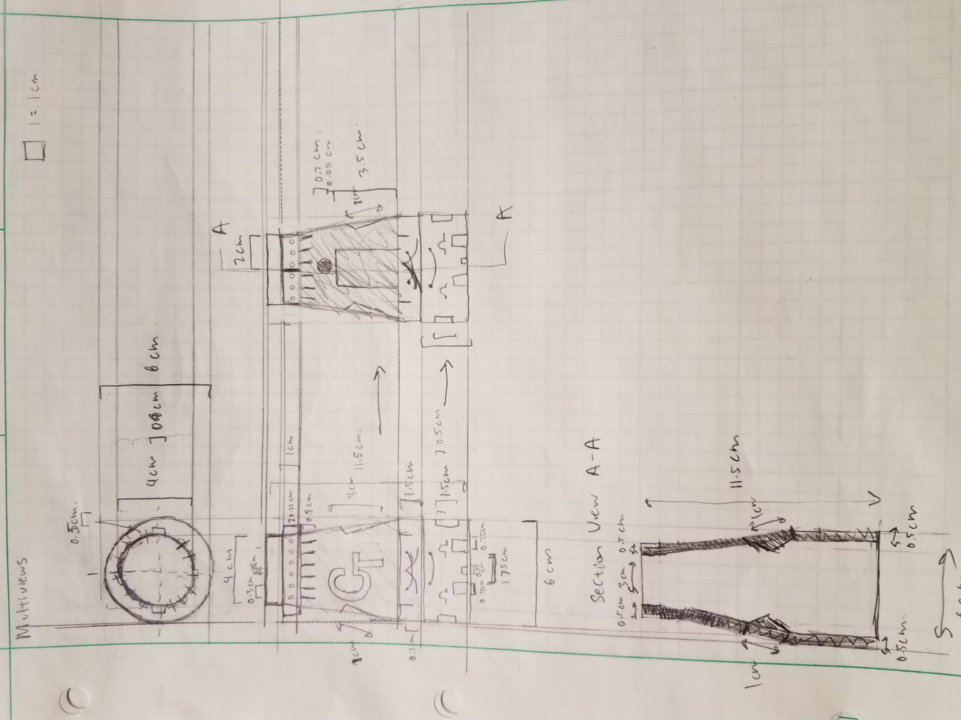
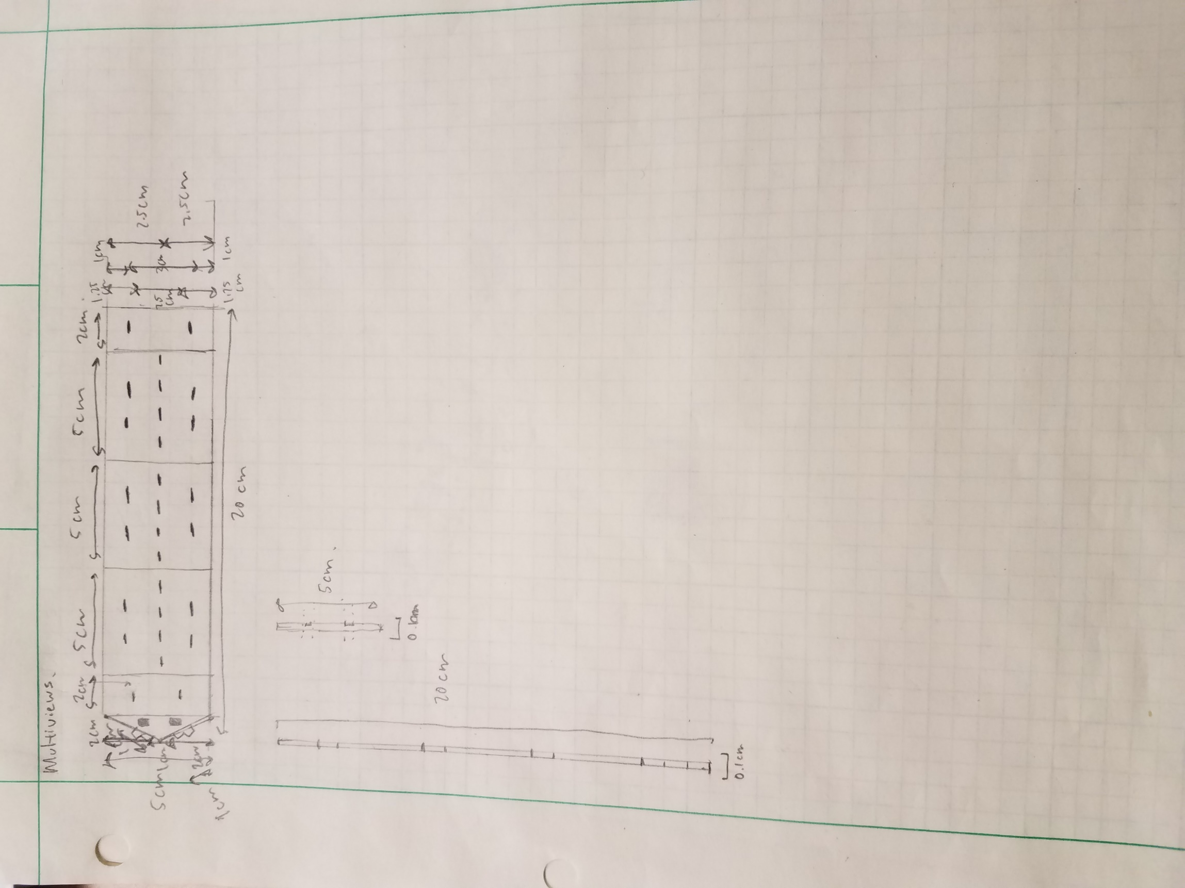
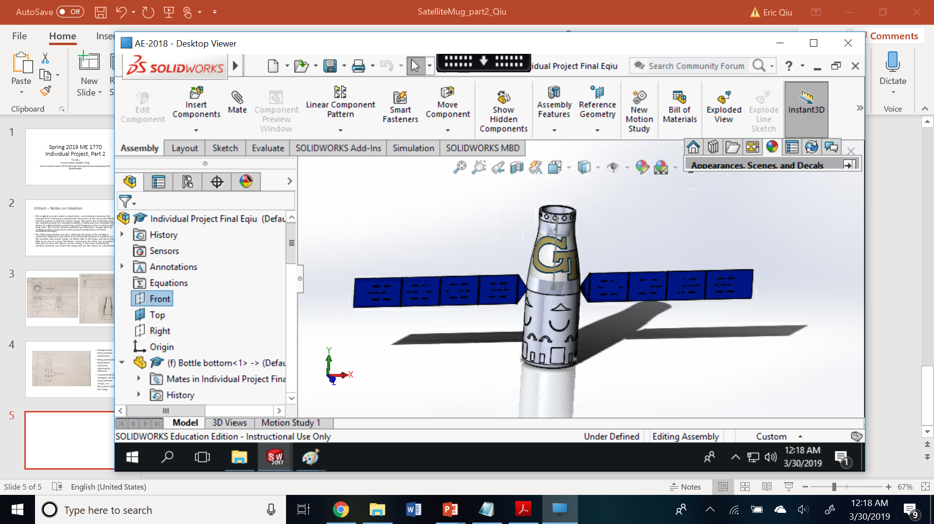
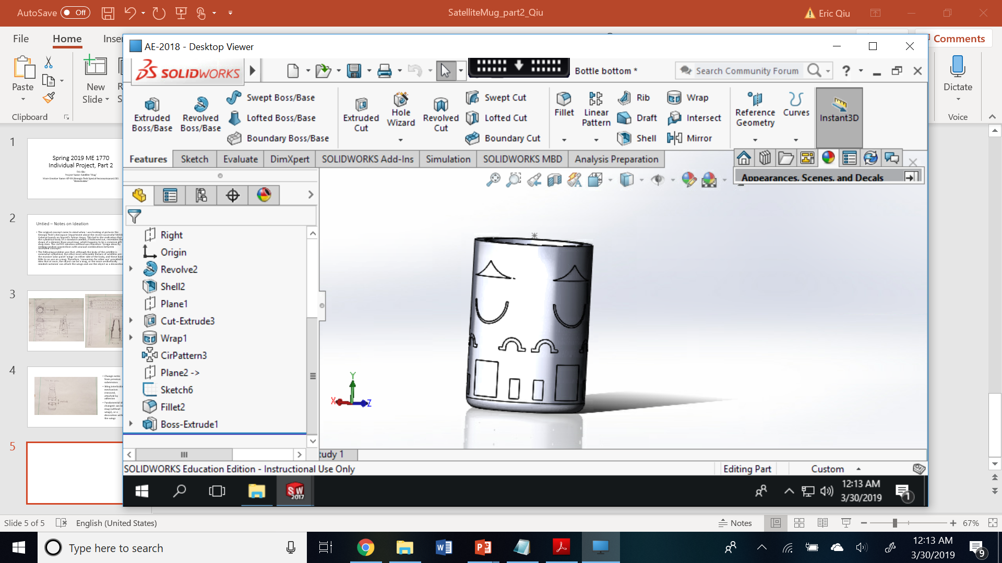
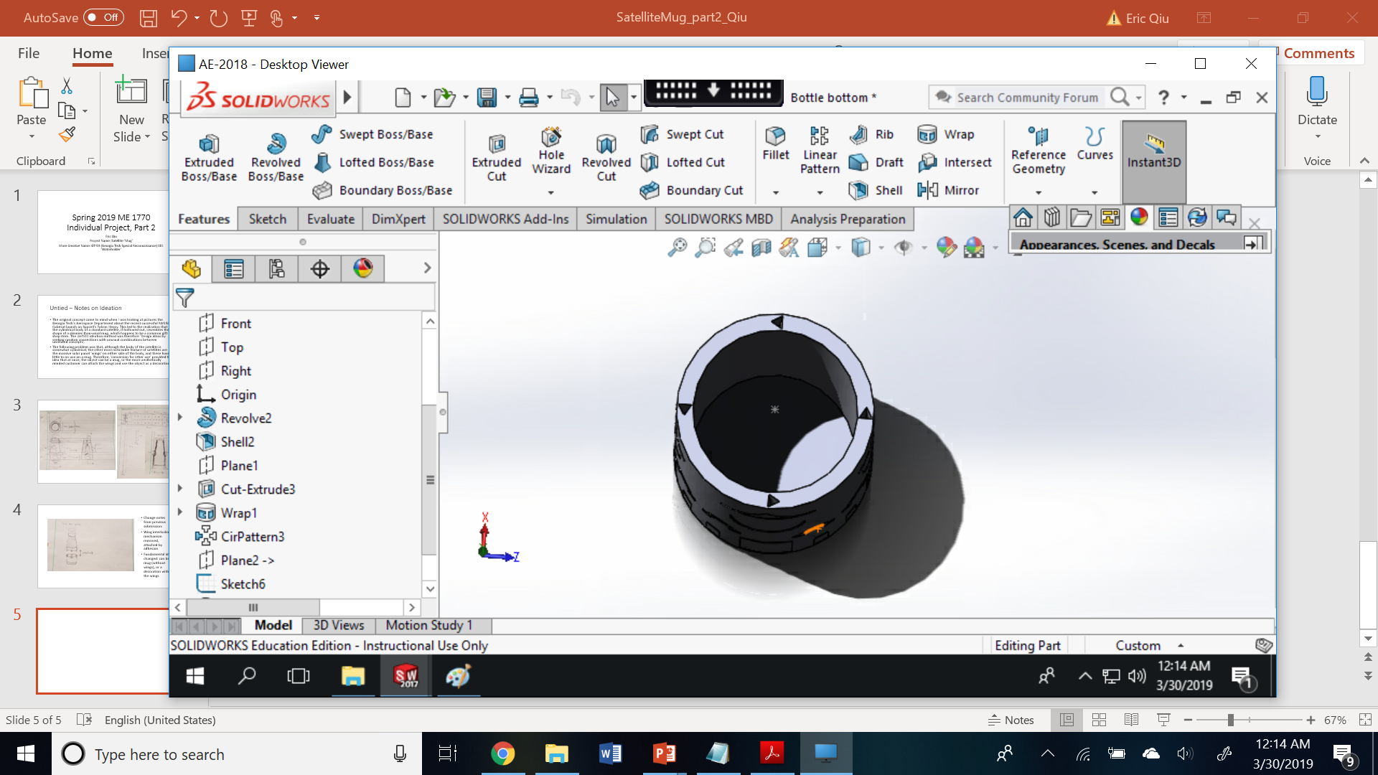
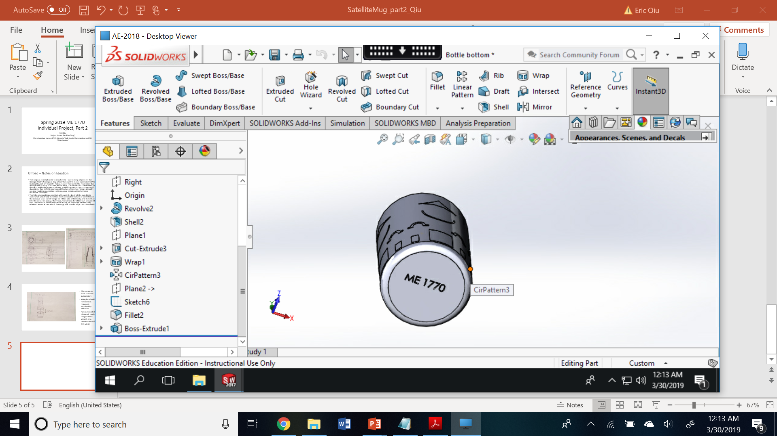
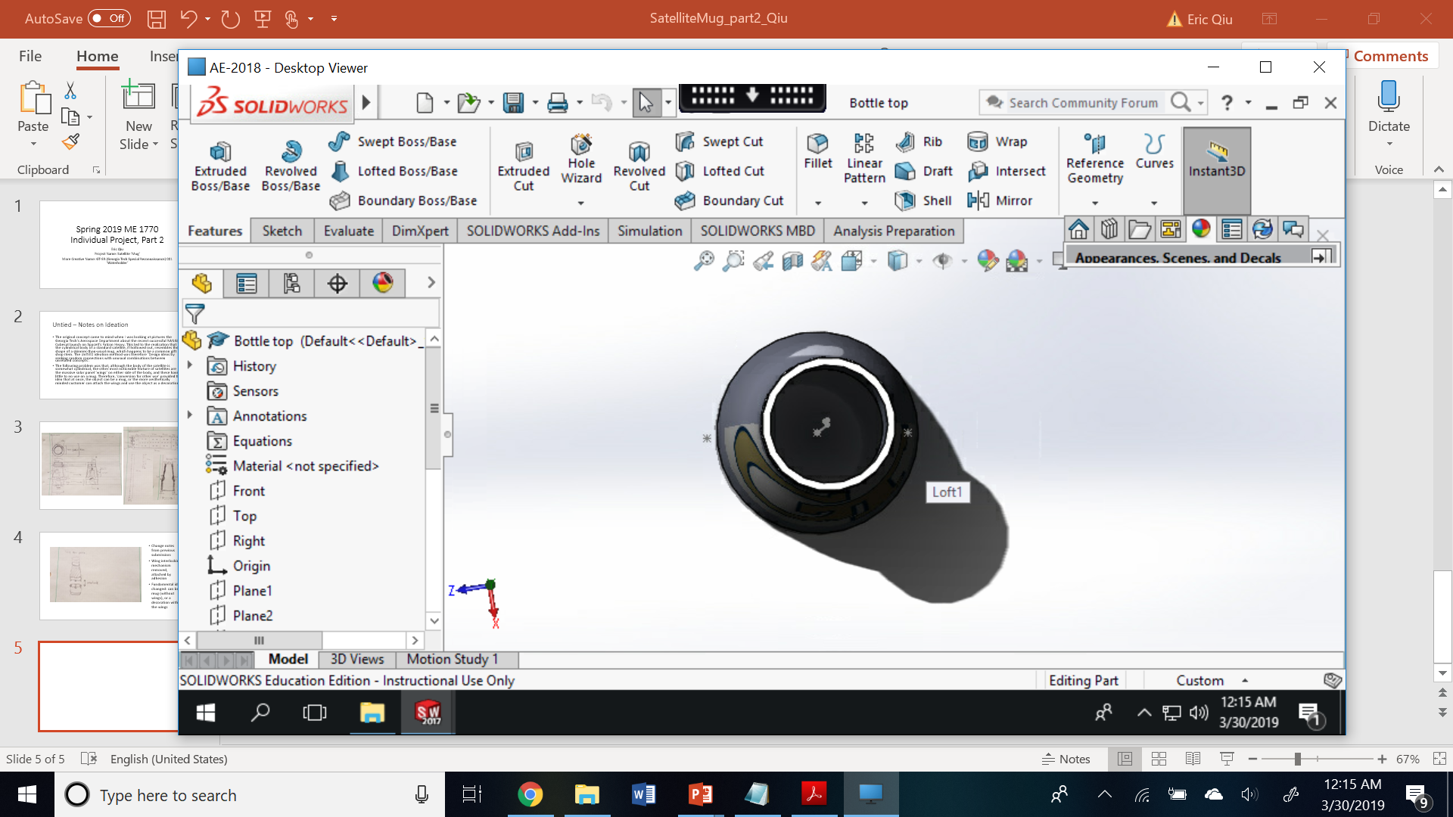
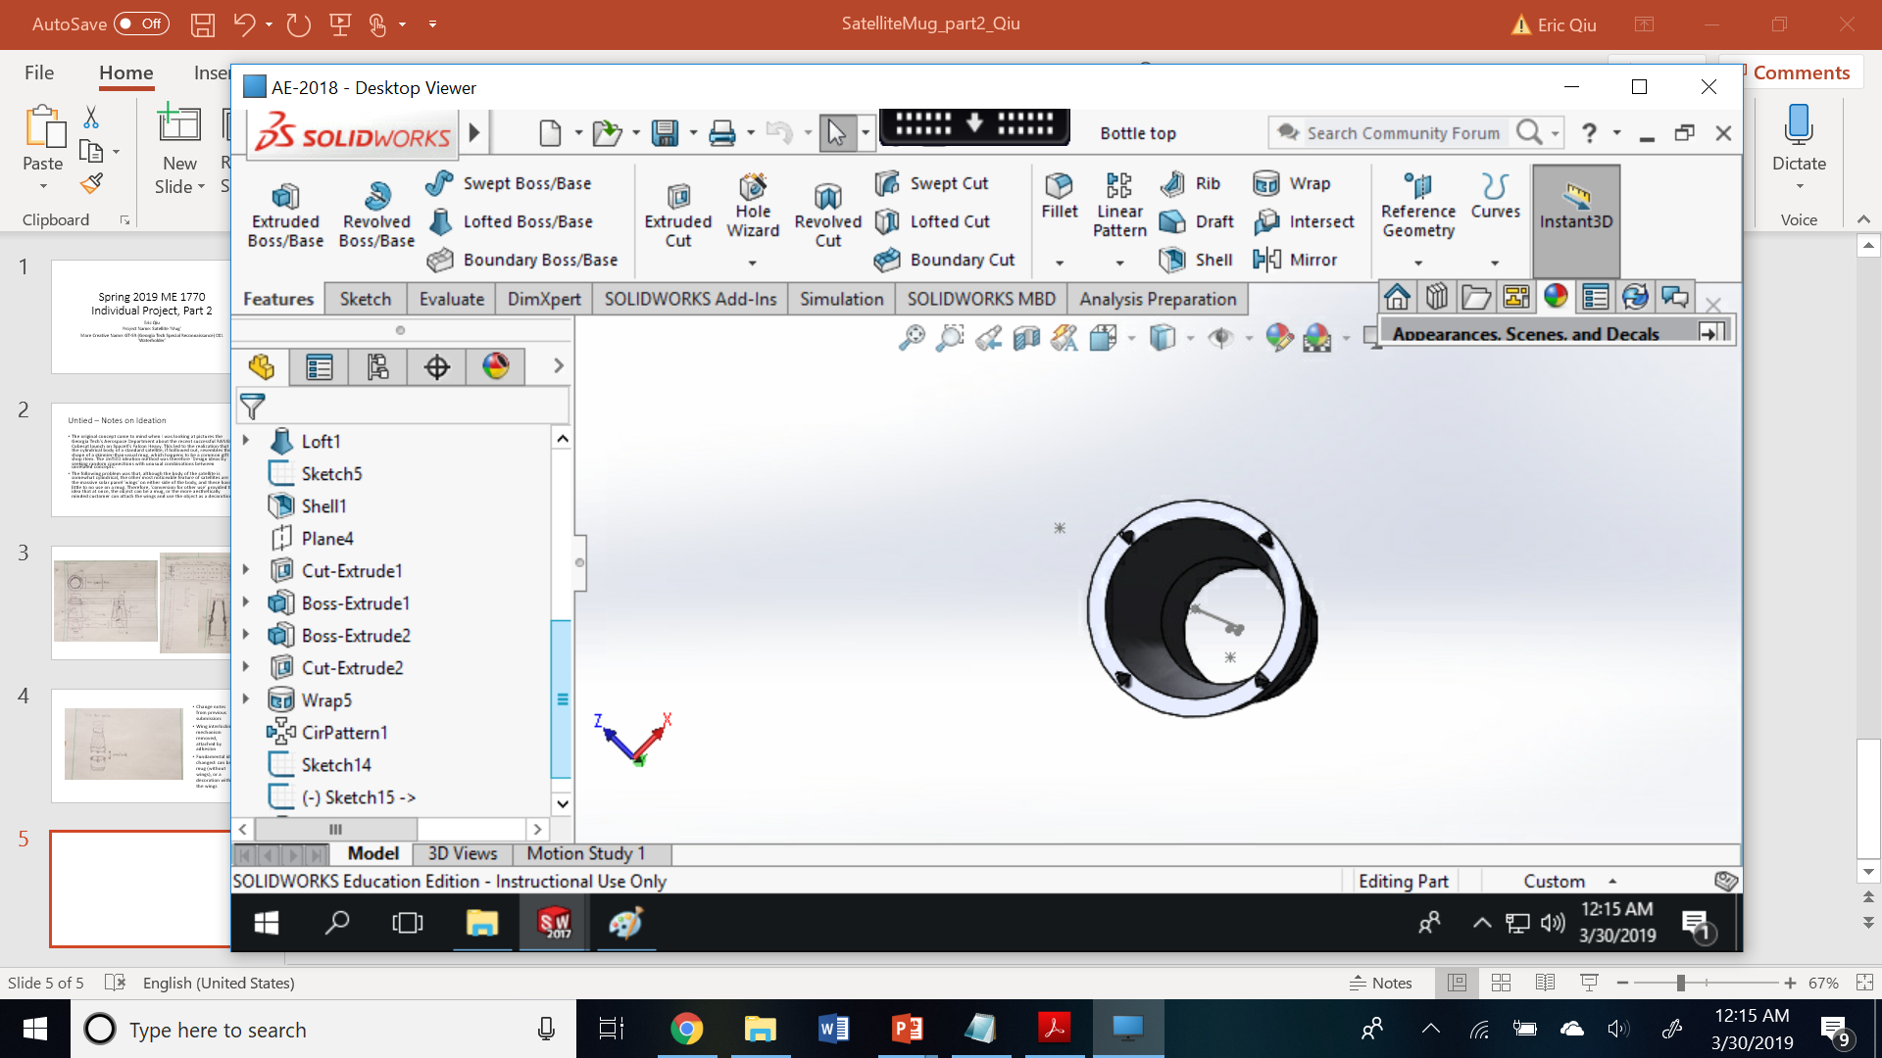
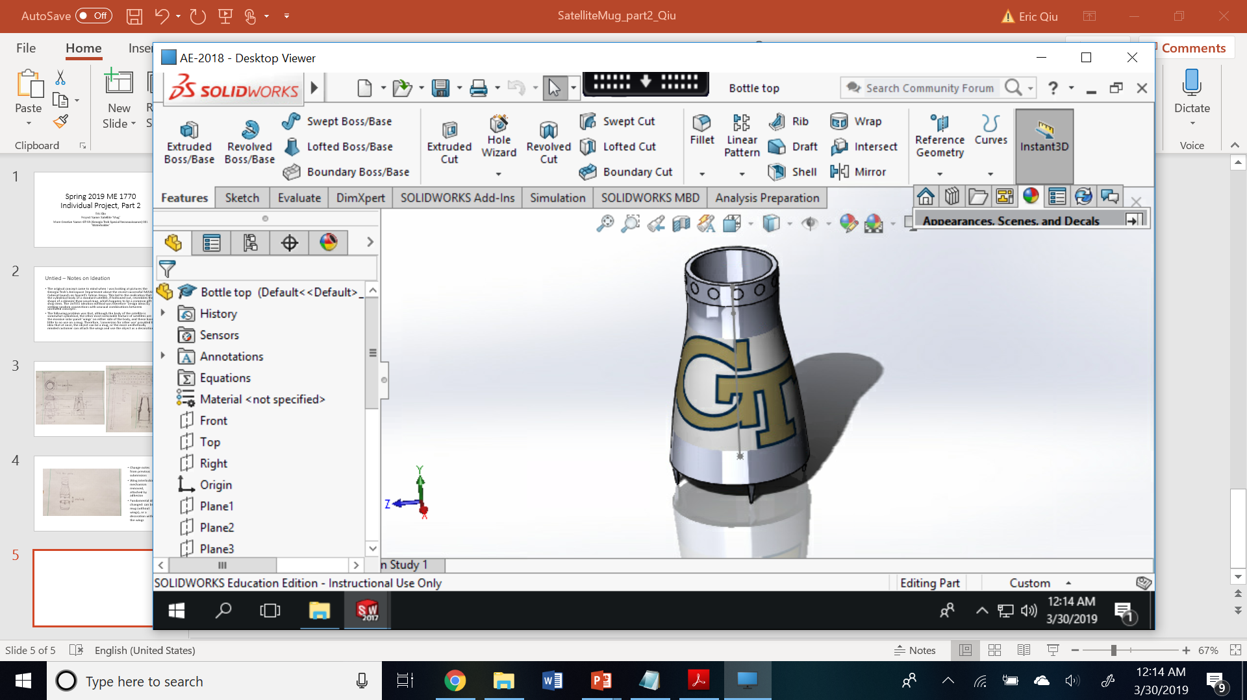
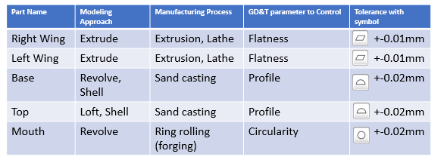
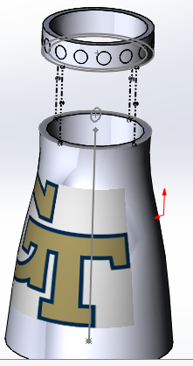
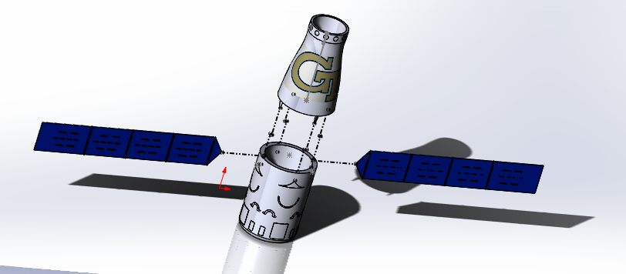
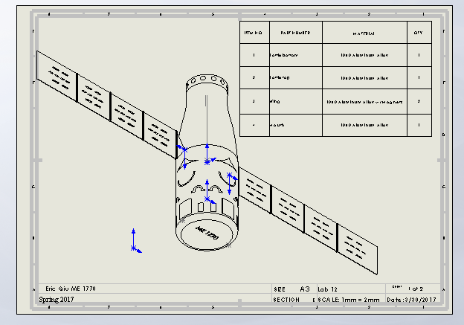
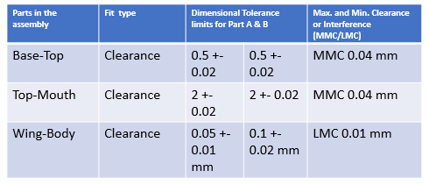
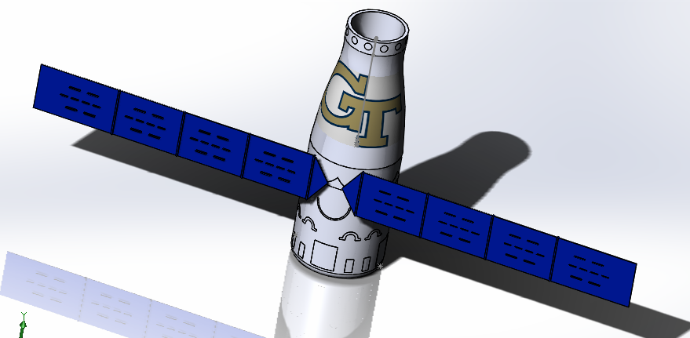
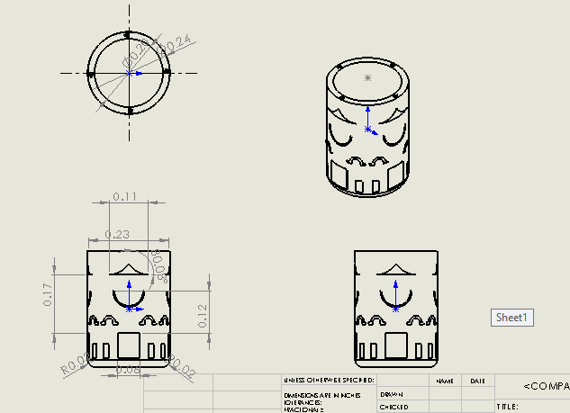
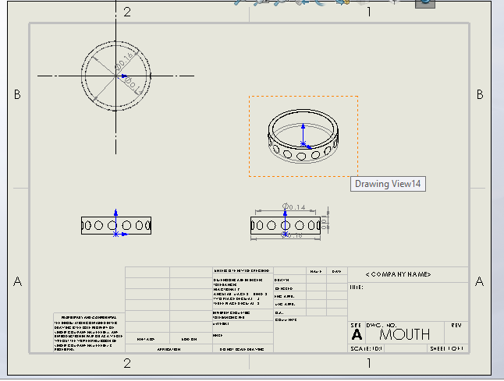
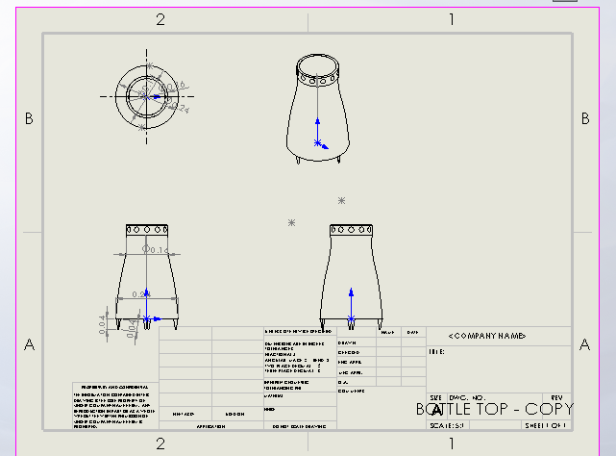
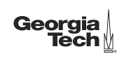
ME 1770 Creative Ideation Design Project
Instructor: Dr. Raghu Pucha
“Satellite-Shaped Water Bottle : GT-SR 001”
Eric Qiu
Product Description and
Creative Ideation
Thumbnail Sketches and Perspective View
The original concept came to mind when I realized that the cylindrical body of a standard satellite, if hollowed out, resembles the shape of a skinnier-than-usual mug, which happens to be a common gift shop item. The UnTiED ideation method was therefore ‘Design ideas by seeking random connections with unusual combinations between unrelated concepts’.
The following problem was that, although the body of the satellite is somewhat cylindrical, the other most noticeable feature of satellites are the massive solar panel ‘wings’ on either side of the body, and these have little to no use on a mug. Therefore, ‘conversion for other use’ provided the idea that at once, the object can be a mug, or the more aesthetically minded customer can attach the wings and use the object as a decoration.
Hand Sketches
Multi-view Drawings
Part and Assembly Models
Hand Sketches
CAD (Define material / texture or Color for each part)
All parts: 1060 Aluminum Alloy
Body/Mouth: RGB (203, 210, 239)
Wings: RGB (0,31,191)
GDT , Part working Drawings and Assembly Instructions
Step 1
Step 2
CAD
Step 3
The wings are magnetic and can be assembled in many different permutations.

